Slide 1


Slide 2


EduEats
Second Year Project Synopsis
Submitted by
ROLL | NAME
2301420058 | Adarsh Kumar Sharma
2301420057 | Shivam Raj
Industry Mentor: Mr. Santosh Kumar
Faculty Mentor: Ms. Radhika Gupta
Notes:
New Courses replaced with New Programmes

Slide 3

INTRODUCTION
EduEats is an innovative campus food ordering portal designed to streamline the food ordering process for students and faculty. The platform enables users to browse menus, place orders, and receive real-time updates on their food status, thereby reducing the need for long queues and manual ordering. By integrating digital payments and order tracking.This system not only simplifies the ordering process but also addresses the specific needs of college environments, where time management is crucial for students balancing academic responsibilities.
Notes:
New Courses replaced with New Programmes

Slide 4
Problem Statement
Define the Problem Clearly
The traditional food ordering process in campus cafeterias is inefficient, causing long queues, order mismanagement, and payment difficulties. This negatively impacts students, faculty, and cafeteria staff.
Why is it Important?
Saves time for students and faculty.
Reduces workload for cafeteria staff.
Improves overall operational efficiency.
Expected Impact of Solving This Problem
Faster and hassle-free food ordering.
Enhanced user experience with digital payments.
Streamlined order management for cafeteria vendors.
Notes:
New Courses replaced with New Programmes

Slide 5
Objectives
To Create a User-Friendly and Scalable Online Food Ordering Platform: The platform will be designed to be easy to navigate for all users while also being strong enough to manage a high volume of orders during busy periods.
To Incorporate Real-Time Order Tracking and Cashless Payment Options: Users will be able to see the status of their orders while enjoying the ease of secure online payments.
To Decrease Waiting Times with Automated Pre-Ordering Features: Allowing users to place their orders ahead of time will help to better manage traffic in the cafeteria.
To Enhance Vendor Efficiency with Order Management Automation: Streamlining the order processing will reduce human error and accelerate service delivery.
Notes:
New Courses replaced with New Programmes

Slide 6
Technical Overview
Frontend Development:
Technologies: React.js, Tailwind CSS, JavaScript
Features:
Responsive landing page with Login/Signup (role-based access)
Menu page with food categories, prices, images
Interactive cart(add, update, remove items)
Order confirmation page with estimated wait time.
Backend Development:
Framework: Node.js with Express.js
Functionalities:
Secure user authentication with password hashing.
Order processing and status updates.
Admin dashboard for menu and order management.
Database:MongoDB Atlas (NoSQL Cloud DB)
Collections :
Users: Stores user details (ID, name, email, password).
Menu: Lists food items (ID, name, price, category).
Orders: Tracks orders (ID, user_id, items, status).
Notes:
New Courses replaced with New Programmes

Slide 7
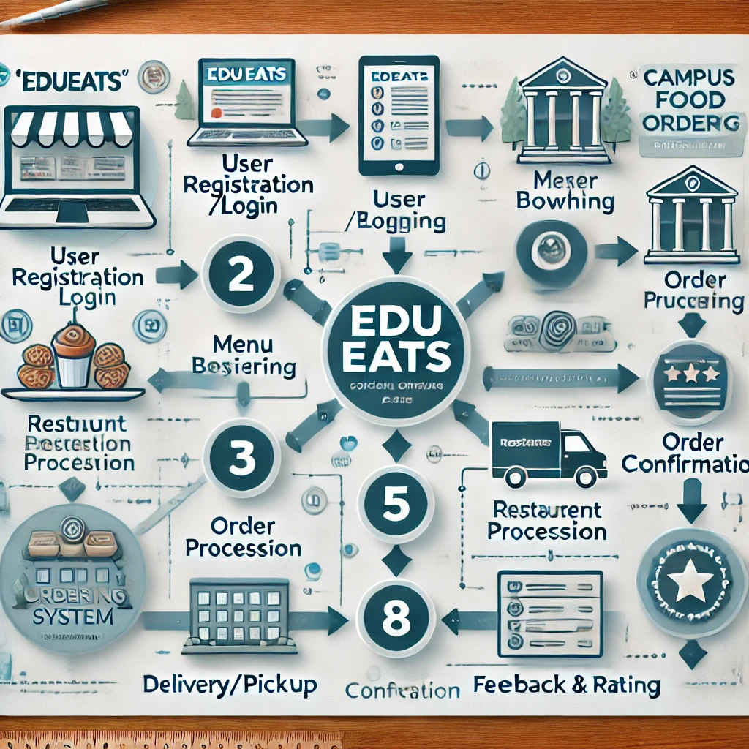
Methodology Flowchart
Notes:
New Courses replaced with New Programmes

Slide 8
Key Features
Core Features:
Digital Menu: Browse categorized food items with real-time availability.
Seamless Ordering: Add, modify, or remove items in the cart before checkout.
Admin Dashboard: Real-time order tracking and menu management for canteen staff.
Responsive Design: Optimized for desktops, tablets, and smartphones.
Notes:
New Courses replaced with New Programmes

Slide 9
Future Scope
Future Enhancements:
Payment Integration: Add UPI, Paytm, or QR code payments for cashless transactions.
Mobile Application: Develop Android/iOS apps using Flutter or React Native.
Real-Time Tracking: Introduce live order status updates with preparation times.
Notifications: Implement SMS or email alerts for order confirmations.
Notes:
New Courses replaced with New Programmes

Slide 10
THANK YOU

